Slide 1

Copper, a new economic estimator ?

Slide 2
The OBJECTIVES
“Copper price reflects grim assessment of global economy …
The metal, which has long been seen as a health check for the global economy …”
Financial Times , October 2019
CAN WE CONSIDER THE PRICE OF COPPER AS A VIABLE ECONOMIC ESTIMATOR TO PREDICT RECESSION?
CAN WE EXPECT IN THE NEXT TWELVE MONTHS A NEW RECESSION ACCORDING TO MY PREDICTIONS?

Slide 3
data SOURCE
WHAT I LOOKED FOR: DATA SOURCE:
-THE EVOLUTION OF THE PRICE OF COPPER… - US FEDERAL RESERVE
- OECD
- ECONOMIC ESTIMATORS ( GDP, YIELD CURVE, CCI…) - WORLD BANK

Slide 5
STEPS BEFORE MACHINE LEARNING
CLEAN THE DATA…
LOOK FOR PATTERNS AND SEASONALITY (TIME SERIES)…
RESAMPLE THE DATA BEFORE USING PROPHET…
USE FB.PROPHET TO CREATE TIME SERIES FOR EACH PARAMETER AND MAKE PREDICTIONS…
MERGE THE DIFFERENT PARAMETERS TOGETHER AND CREATE A DATAFRAME THAT POSSESS FORECASTED VALUES…

Slide 6
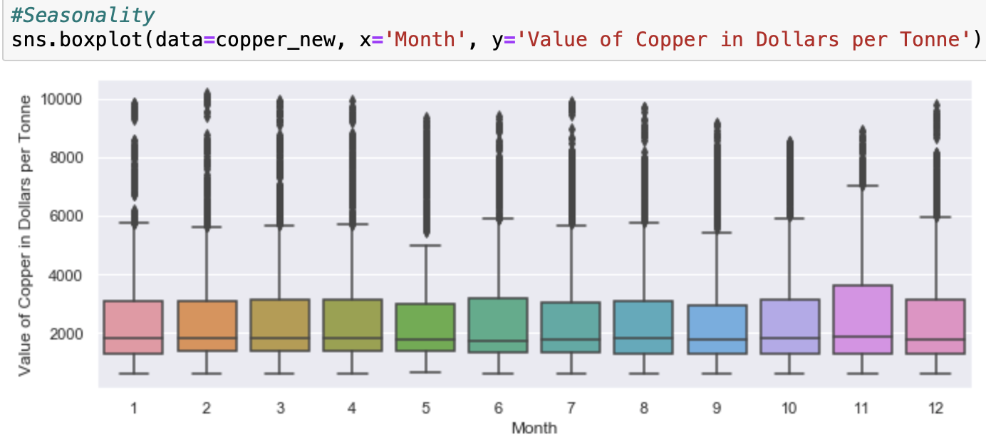
Seasonality?

Slide 7
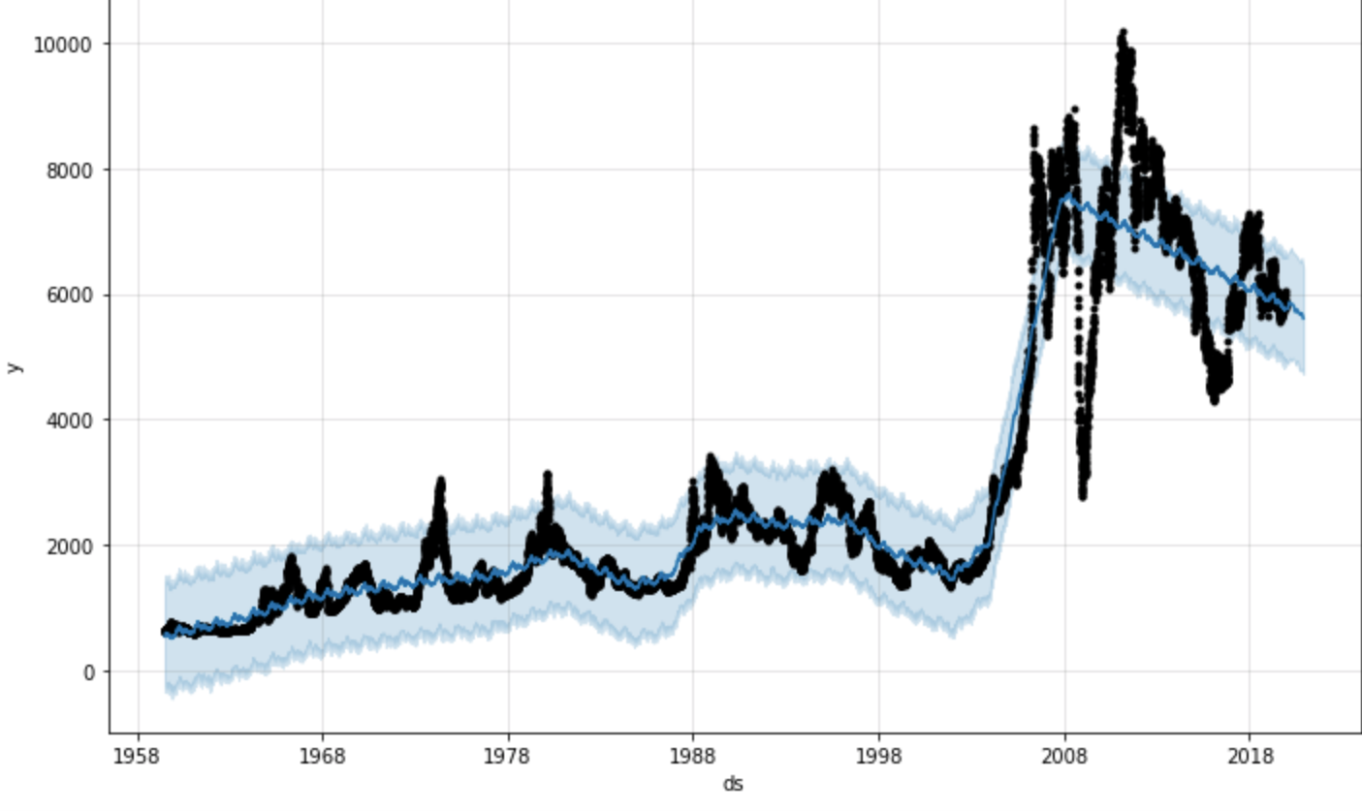
Expected trend ?

Slide 8
MACHINE LEARNING learnings
I DIVIDED THE MACHINE LEARNING PROCESS IN 2 PARTS:
APPLY RANDOM FOREST & LOGISTIC REGRESSION ALGORITHM ON THE DATAFRAME ( CCI,YIELD,COPPER,RECESSION) WITH THE TRUE VALUES …
APPLY THE SAME ALGORITHMS ON THE FORECASTED VALUES (FROM PROPHET) TO PREDICT RECESSION…
N.B: I HAD TO APPLY THOSE MODELS ONCE WITH THE PRICE OF COPPER AS A PARAMETER AND ONCE WITHOUT…

Slide 9
Results
… I CHOSE THE RANDOM FOREST ALGORITHM OVER LOGISTIC REGRESSION BECAUSE ALL THE TEST I HAVE USED TO CHECK EFFICIENCY GAVE BETTER RESULTS…
ML ON TRUE VALUES (TRAIN ,TEST: 1970:2006 & PREDICT:2006-2009):
RANDOM FOREST WITH COPPER: 78% ON THE F1 SCORE & 85 % ACCURACY ON PREDICTING VALUES.
-RANDOM FOREST WITHOUT COPPER: 73% ON THE F1 SCORE & 81 % ACCURACY ON PREDICTING VALUES
ML ON FORECASTED VALUES ( TRAIN,TEST: 1970-2019 & PREDICT: 2020):
RANDOM FOREST WITH COPPER: F1 SCORE 75%
RANDOM FOREST WITHOUT COPPER: 60 %

Slide 10
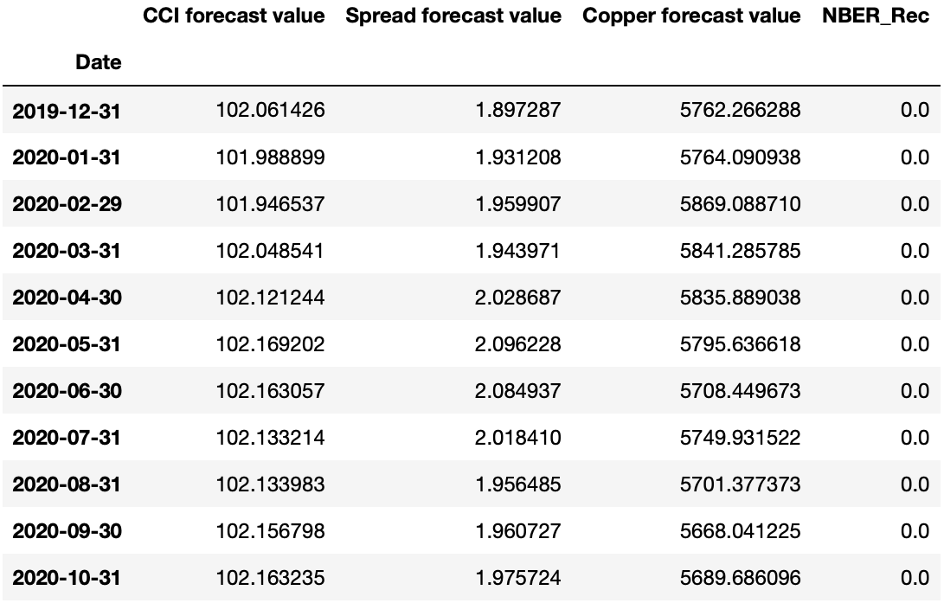
Forecast

Slide 11
CONCLUSIONS
FB.PROPHET IS A VERY INTERESTING TOOL TO PERFORM TIME SERIES…
RANDOM FOREST ALGORITHM GIVES BETTER ACCURACY THAN LOGOSTIC REGRESSION
MODELS THAT USE THE PRICE OF COPPER, AS A PARAMETER TO PREDICT RECESSION, GIVE BETTER RESULTS…
ACCORDING TO MY FINDINGS, THE ECONOMY SHOULD NOT FALL INTO RECESSION IN 2020 …

Slide 12
IMPROVEMENTS
LOOK AT MORE ECONOMIC ESTIMATORS SUCH AS DEBT LEVEL OR UNEMPLOYEMENT LEVEL…
TAKE INTO CONSIDERATION CHINA IN THE CONSUMPTION AND PRODUCTION OF COPPER…
USE XG BOOST INSTEAD OF PROPHET TO MODEL TIME SERIES…
FIND OTHER ALGORITHMS TO IMPROVE ACCURACY…

Slide 13
☺ THANK YOU FOR YOUR ATTENTION ☺
WHAT ARE YOU THOUGHTS ON THE ACTUAL ECONOMIC SITUATION…

